Slide 1


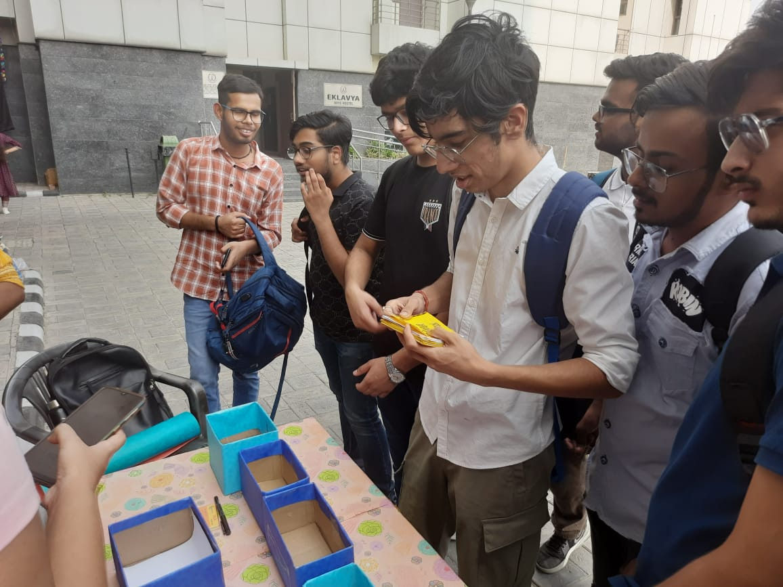
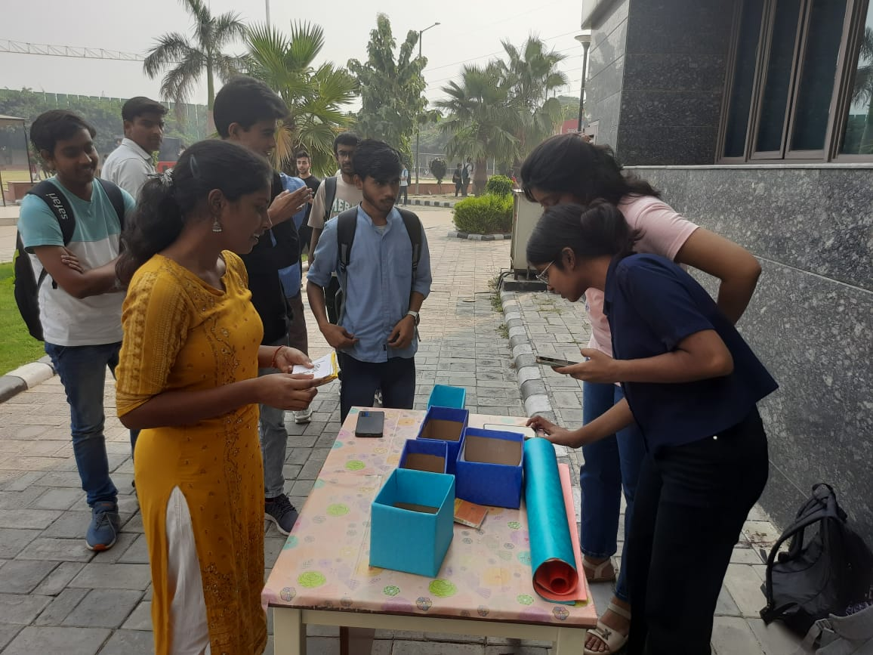
EVENT REPORT : Waste Segregation Challenge
Date: 22nd October 2024
Time: 1 PM to 4 PM
Venue: SSCBS
Event Overview
On October 22nd, 2024, during Viti, the annual fest organized by Kartavya, the EcoClub conducted a dynamic and educational Waste Segregation Challenge. This initiative was designed to promote awareness about the critical importance of waste segregation and encourage sustainable practices among participants.
The activity was conceptualized to engage students, faculty, and staff in a hands-on learning experience about classifying waste into its proper categories, such as biodegradable, recyclable, and non-recyclable. By incorporating an interactive element, the challenge aimed to make environmental awareness both fun and thought-provoking.
Participants not only tested their knowledge of waste management but also developed a deeper understanding of the environmental consequences of improper waste disposal. The activity highlighted the significance of small, conscious actions in creating a larger impact, making it one of the most memorable and impactful events of the fest.
Participation
The Waste Segregation Challenge witnessed an exceptional turnout, with students, faculty members, and staff eagerly participating. Their enthusiasm and curiosity were evident as they approached the challenge with determination and interest in understanding the nuances of proper waste management.
The activity provided an opportunity for participants to showcase their knowledge, engage in critical thinking, and explore innovative approaches to waste segregation. The involvement of individuals from various departments added diversity to the event and further emphasized the collaborative spirit required to address environmental challenges.

Slide 2
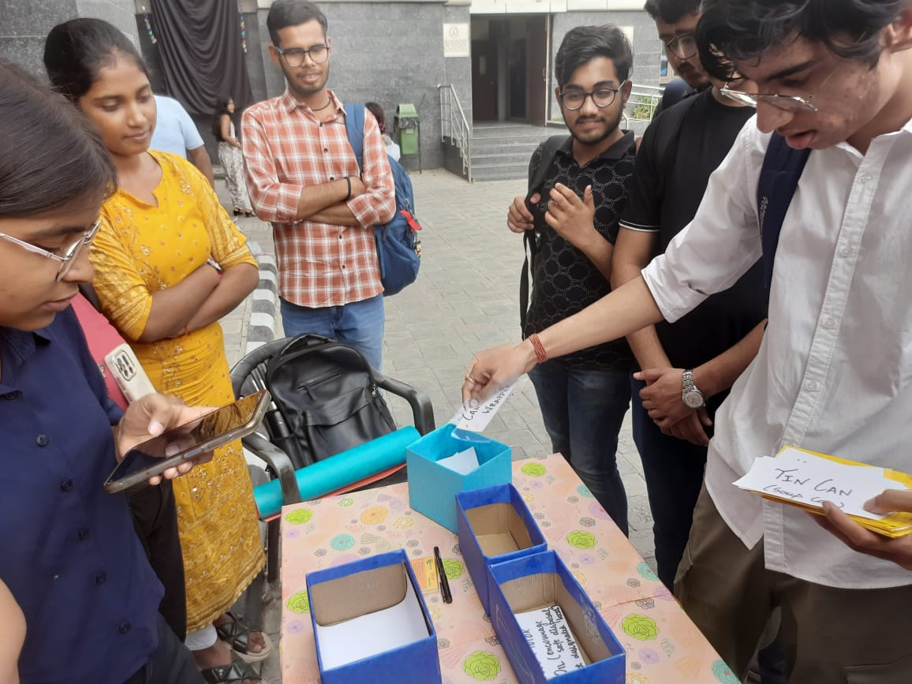
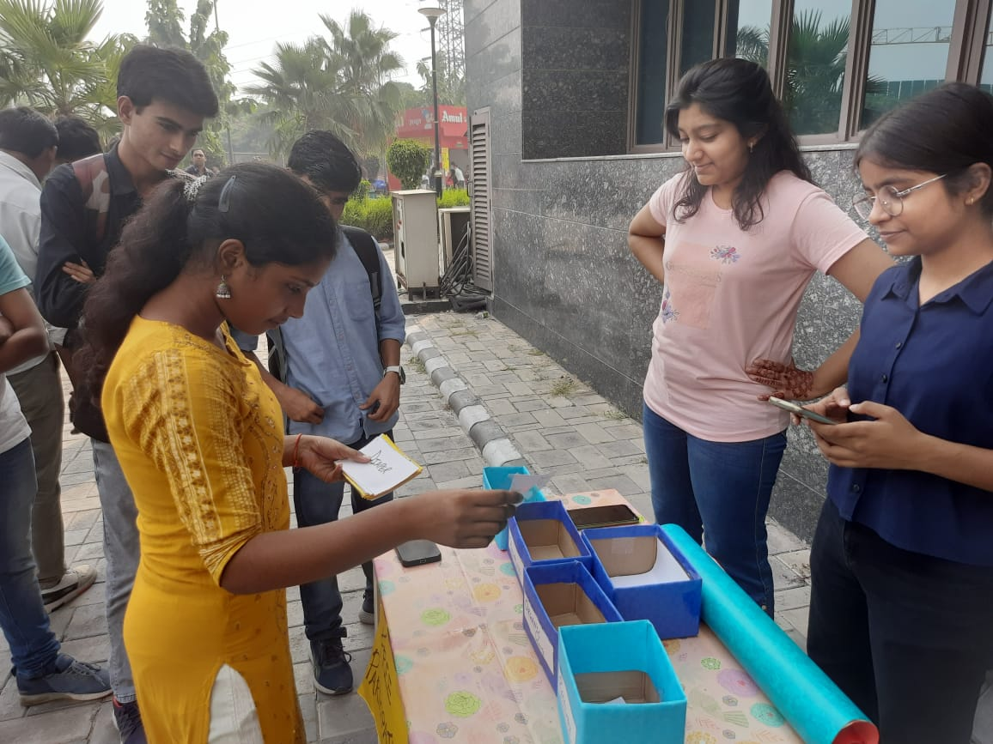
Activities
Setup and Preparation:
The EcoClub team created a visually engaging setup, complete with waste segregation boxes clearly labeled for different categories of waste (e.g., biodegradable, recyclable, and non-recyclable).
Cards featuring a variety of waste items were designed, challenging participants to carefully consider each item's properties and its environmental impact.
Interactive Segregation:
Participants analyzed the cards to determine the correct category of each waste item and placed them into the corresponding boxes.
The activity encouraged problem-solving and decision-making skills as participants evaluated real-life waste scenarios.
Community Engagement:
After completing the challenge, participants were invited to share their reflections and learnings on a public chart. This collaborative activity promoted a sense of shared responsibility and community awareness.
Rewards and Acknowledgment:
To motivate participants, winners were recognized and celebrated for their exceptional performance, inspiring others to adopt sustainable habits.
Impact
The Waste Segregation Challenge left a lasting impression on participants and the broader campus community:
Educational Impact:
Participants gained a thorough understanding of waste categories, learning to distinguish between biodegradable, recyclable, and non-recyclable materials.
The hands-on nature of the activity encouraged active learning and enhanced critical thinking and analytical skills.
Community Building:
The event fostered a sense of unity as participants collaborated and shared their learnings with peers.
It demonstrated the collective power of small, thoughtful actions in creating meaningful environmental change.
Behavioral Changes:
The challenge inspired participants to implement proper waste segregation practices in their daily lives, contributing to a more sustainable future.
It raised awareness about the long-term consequences of improper waste disposal and the benefits of adopting environmentally friendly habits.

Slide 3
Conclusion
In conclusion, the Waste Segregation Challenge at Viti 2024 was a remarkable success, driven by the enthusiasm and active involvement of participants. The event not only educated attendees about waste segregation but also empowered them to take responsibility for their environmental impact.
By promoting critical thinking and fostering community spirit, the challenge underscored the importance of individual and collective actions in achieving sustainability. The EcoClub looks forward to continuing its mission of organizing impactful initiatives that inspire positive change for the environment and society.

