Slide 1


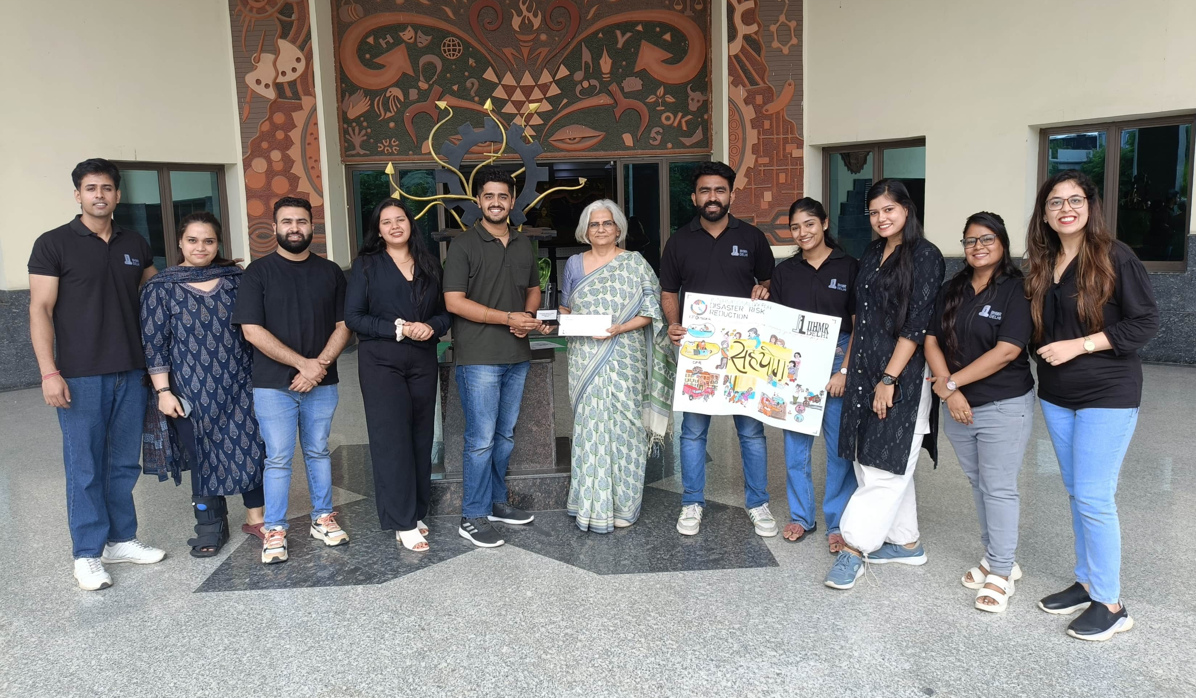
EVENT REPORT :Road Safety Workshop
Date: 27th September 2024
Time: 1 PM to 3 PM
Venue: Room 623, SSCBS
Event Overview
The EcoClub of SSCBS, in collaboration with the Indian Road Safety Campaign and Hero MotoCorp, organized a Road Safety & First Responder Workshop on 27th September 2024. The objective of this workshop was to raise awareness about road safety and equip participants with life-saving skills such as CPR and first aid, fostering a safer and more responsible community.
Participation
The workshop saw an overwhelming response, with over 90+ attendees from various student groups and faculties at SSCBS. A dedicated team of 10+ facilitators from the IIHMR Institute joined the event, providing their expertise on first aid and CPR techniques, ensuring that the participants received hands-on, practical knowledge.

Slide 2
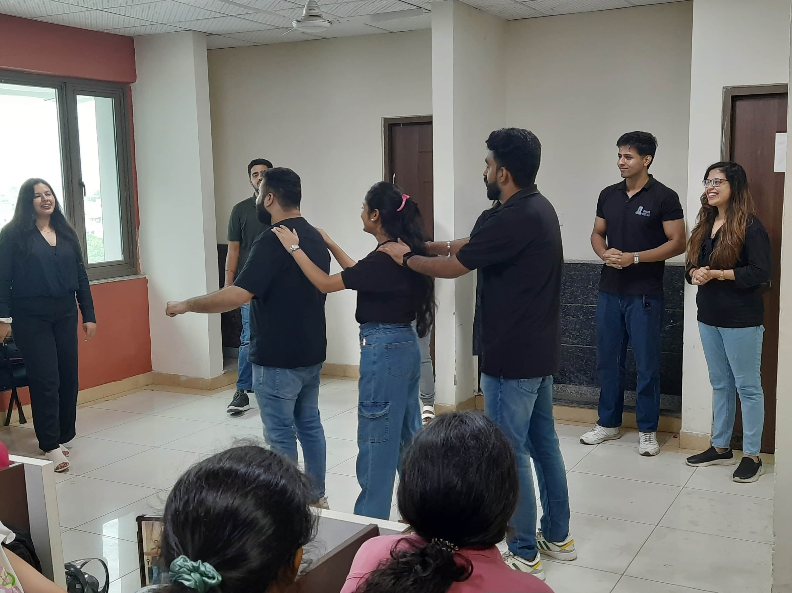
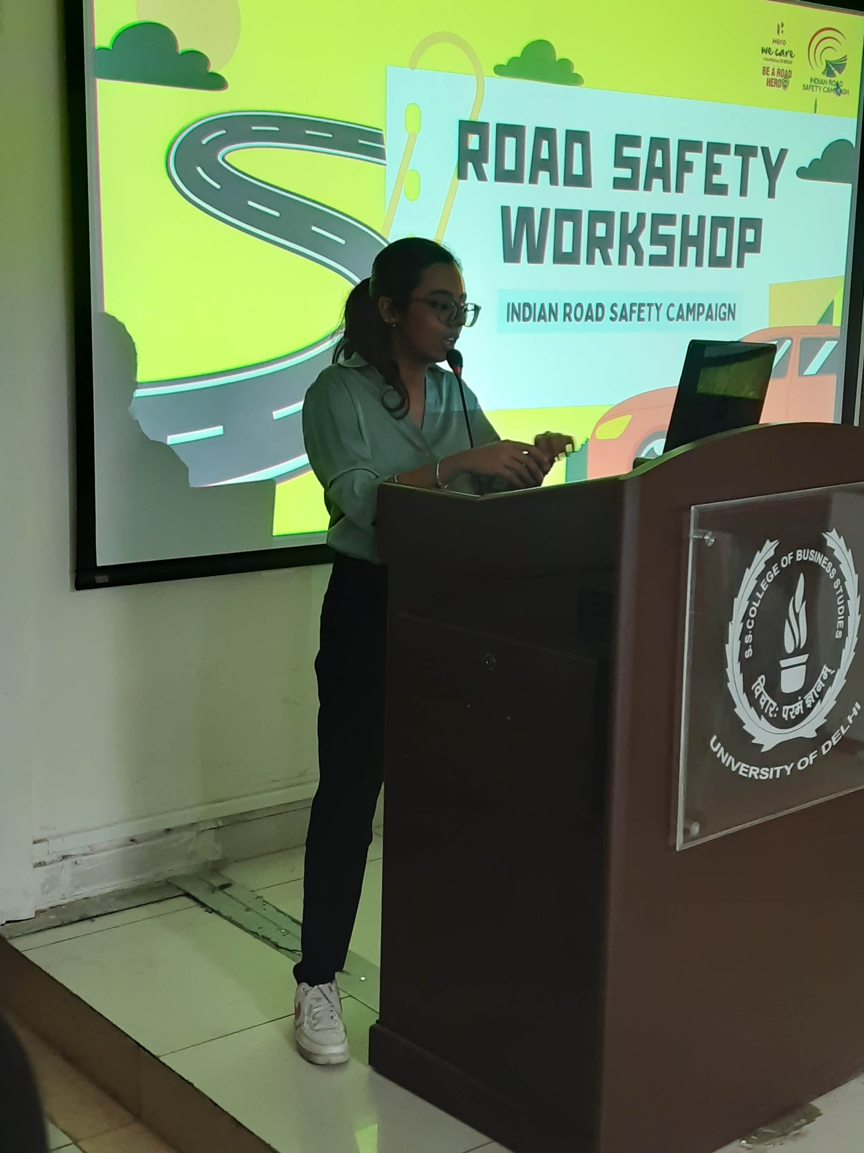
Activities
The event was divided into two main sessions:
Road Safety Awareness Session: This session highlighted critical road safety measures, including best practices to stay safe on roads, the importance of following traffic rules, and ways to prevent accidents. Attendees were encouraged to ask questions and engage with the experts, leading to a highly interactive and informative session.
CPR and First Aid Training: The second session was focused on practical demonstrations of CPR and first aid techniques. The IIHMR team provided step-by-step training, allowing attendees to practice CPR and learn how to handle emergency situations such as accidents and health crises on the road. This hands-on approach made the session both engaging and educational.
Impact
The workshop made a significant impact on the participants. The interactive nature of the sessions allowed attendees to better understand the importance of road safety and how crucial it is to remain alert while on the road. Additionally, the practical demonstrations of CPR and first aid provided them with the confidence and skills to respond effectively in emergency situations. Participants left the workshop with enhanced knowledge of life-saving techniques and a greater sense of responsibility towards road safety.

Slide 3
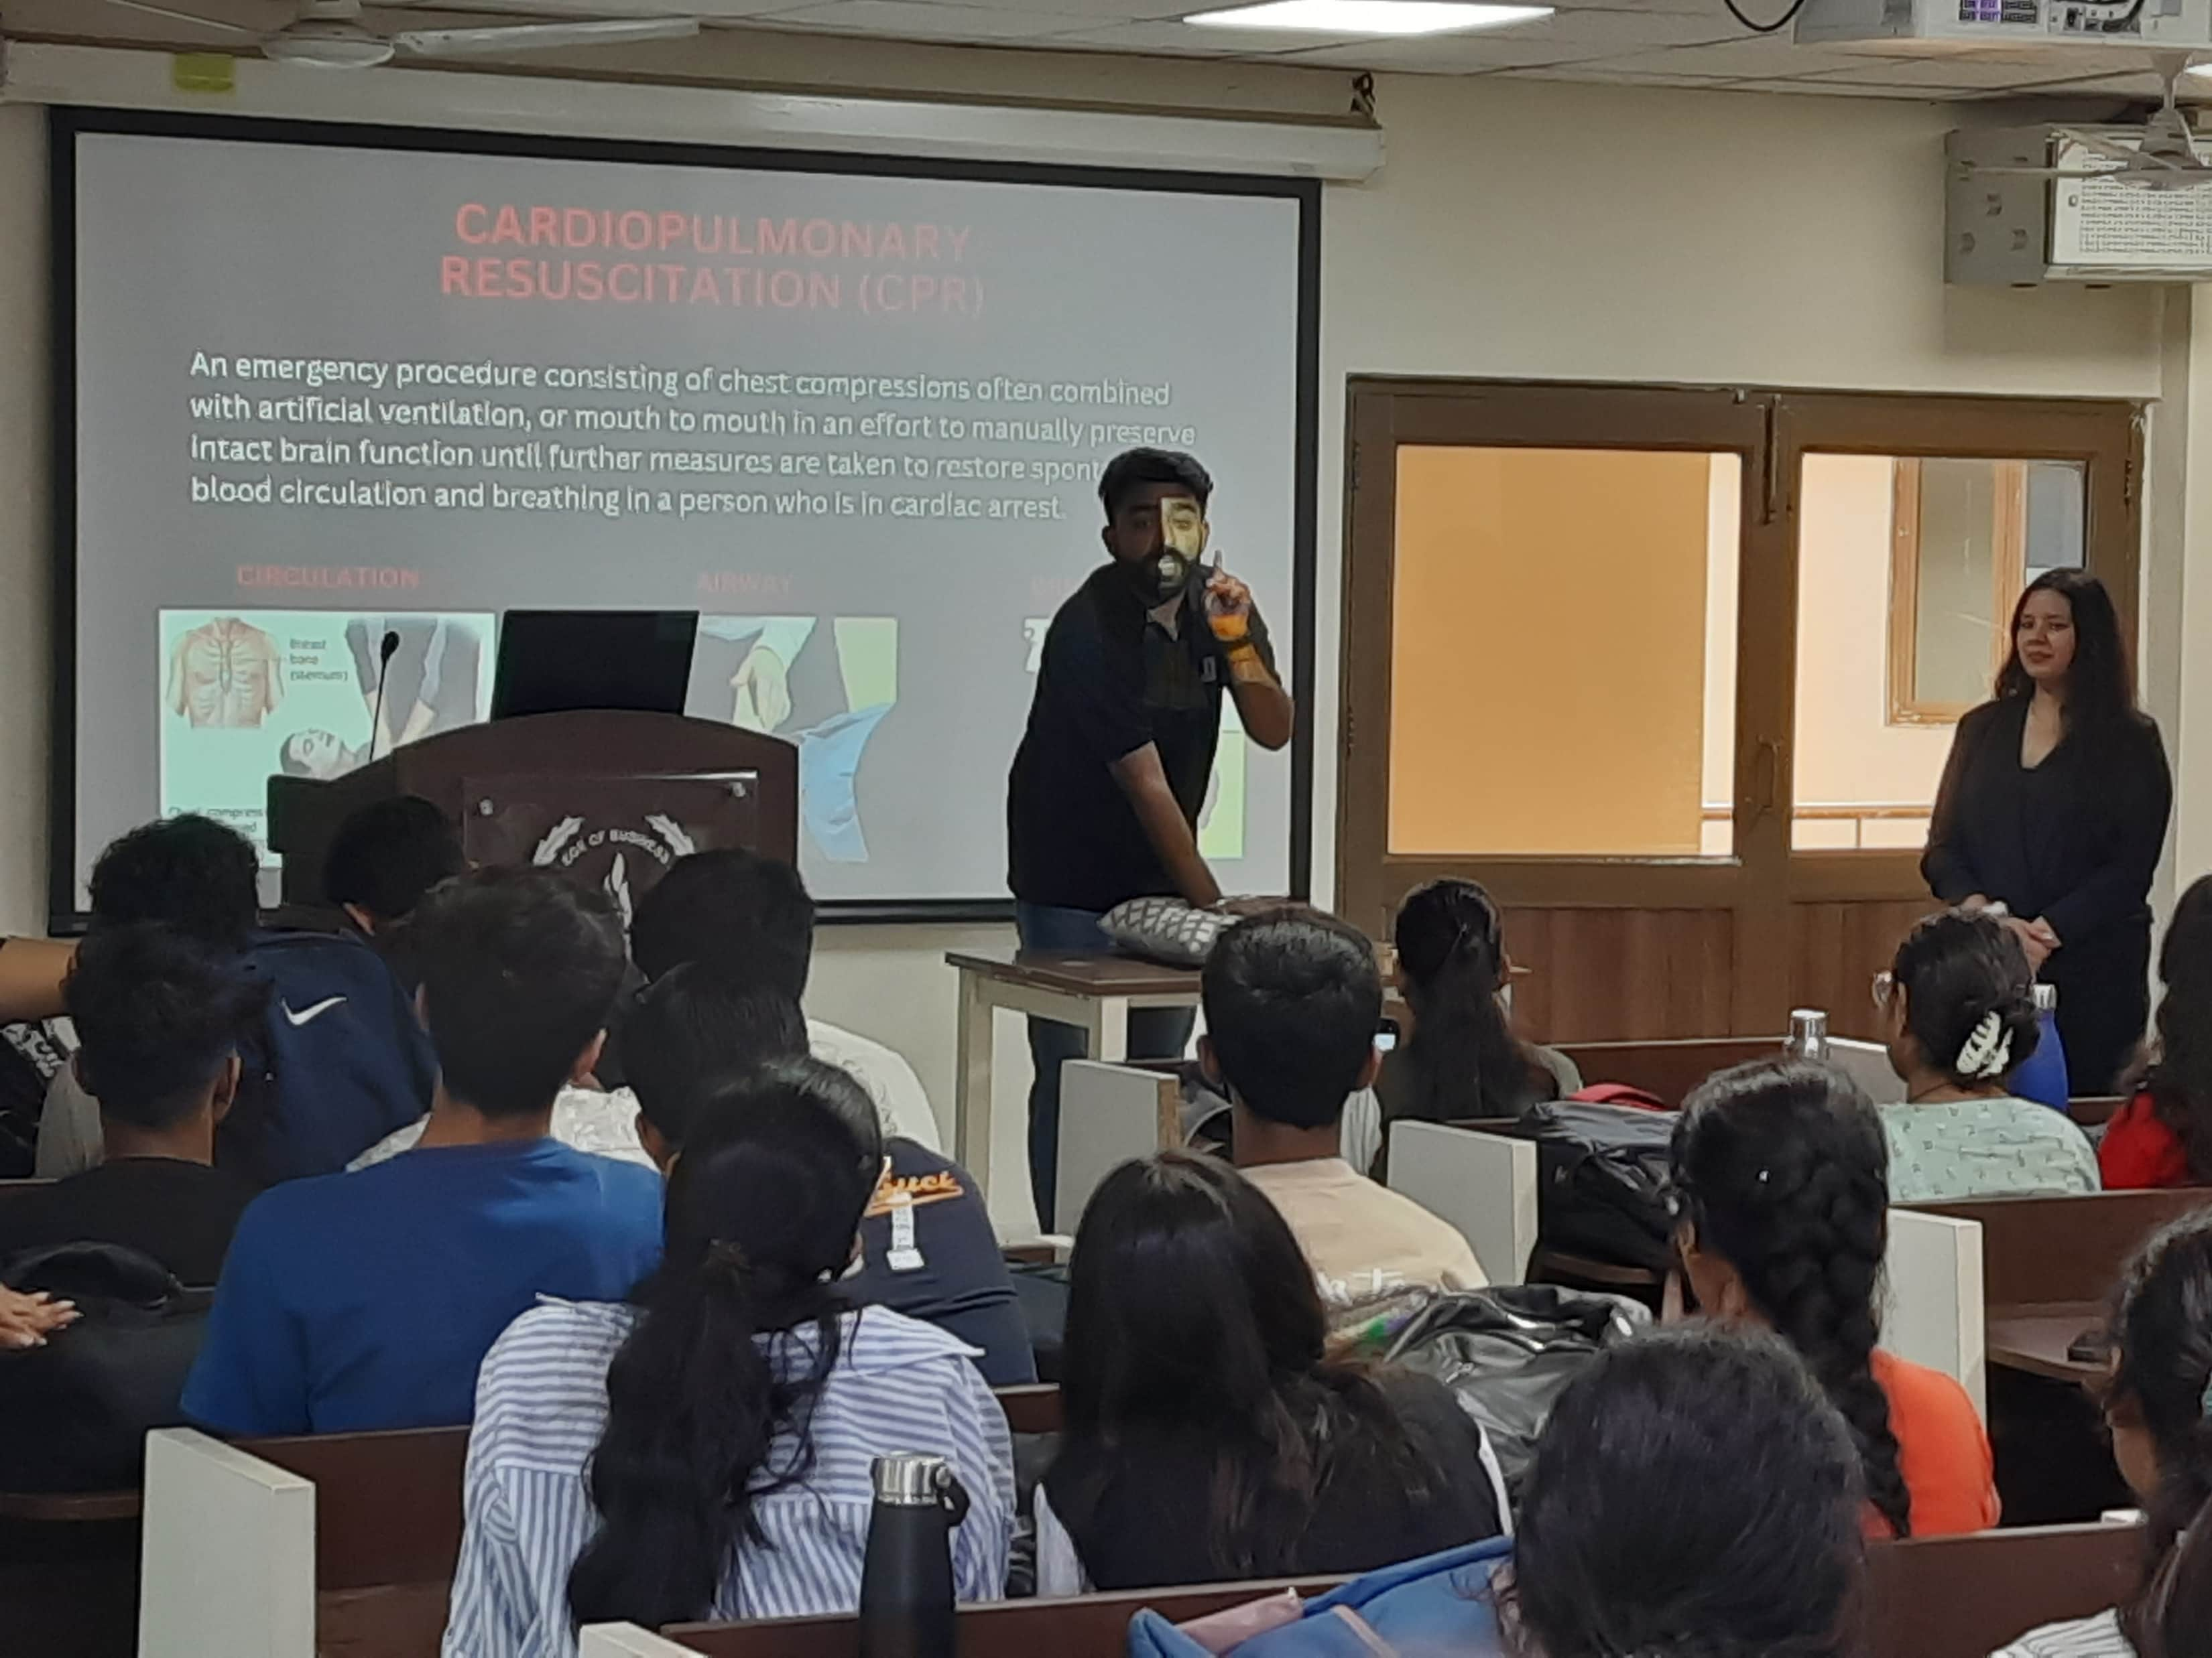
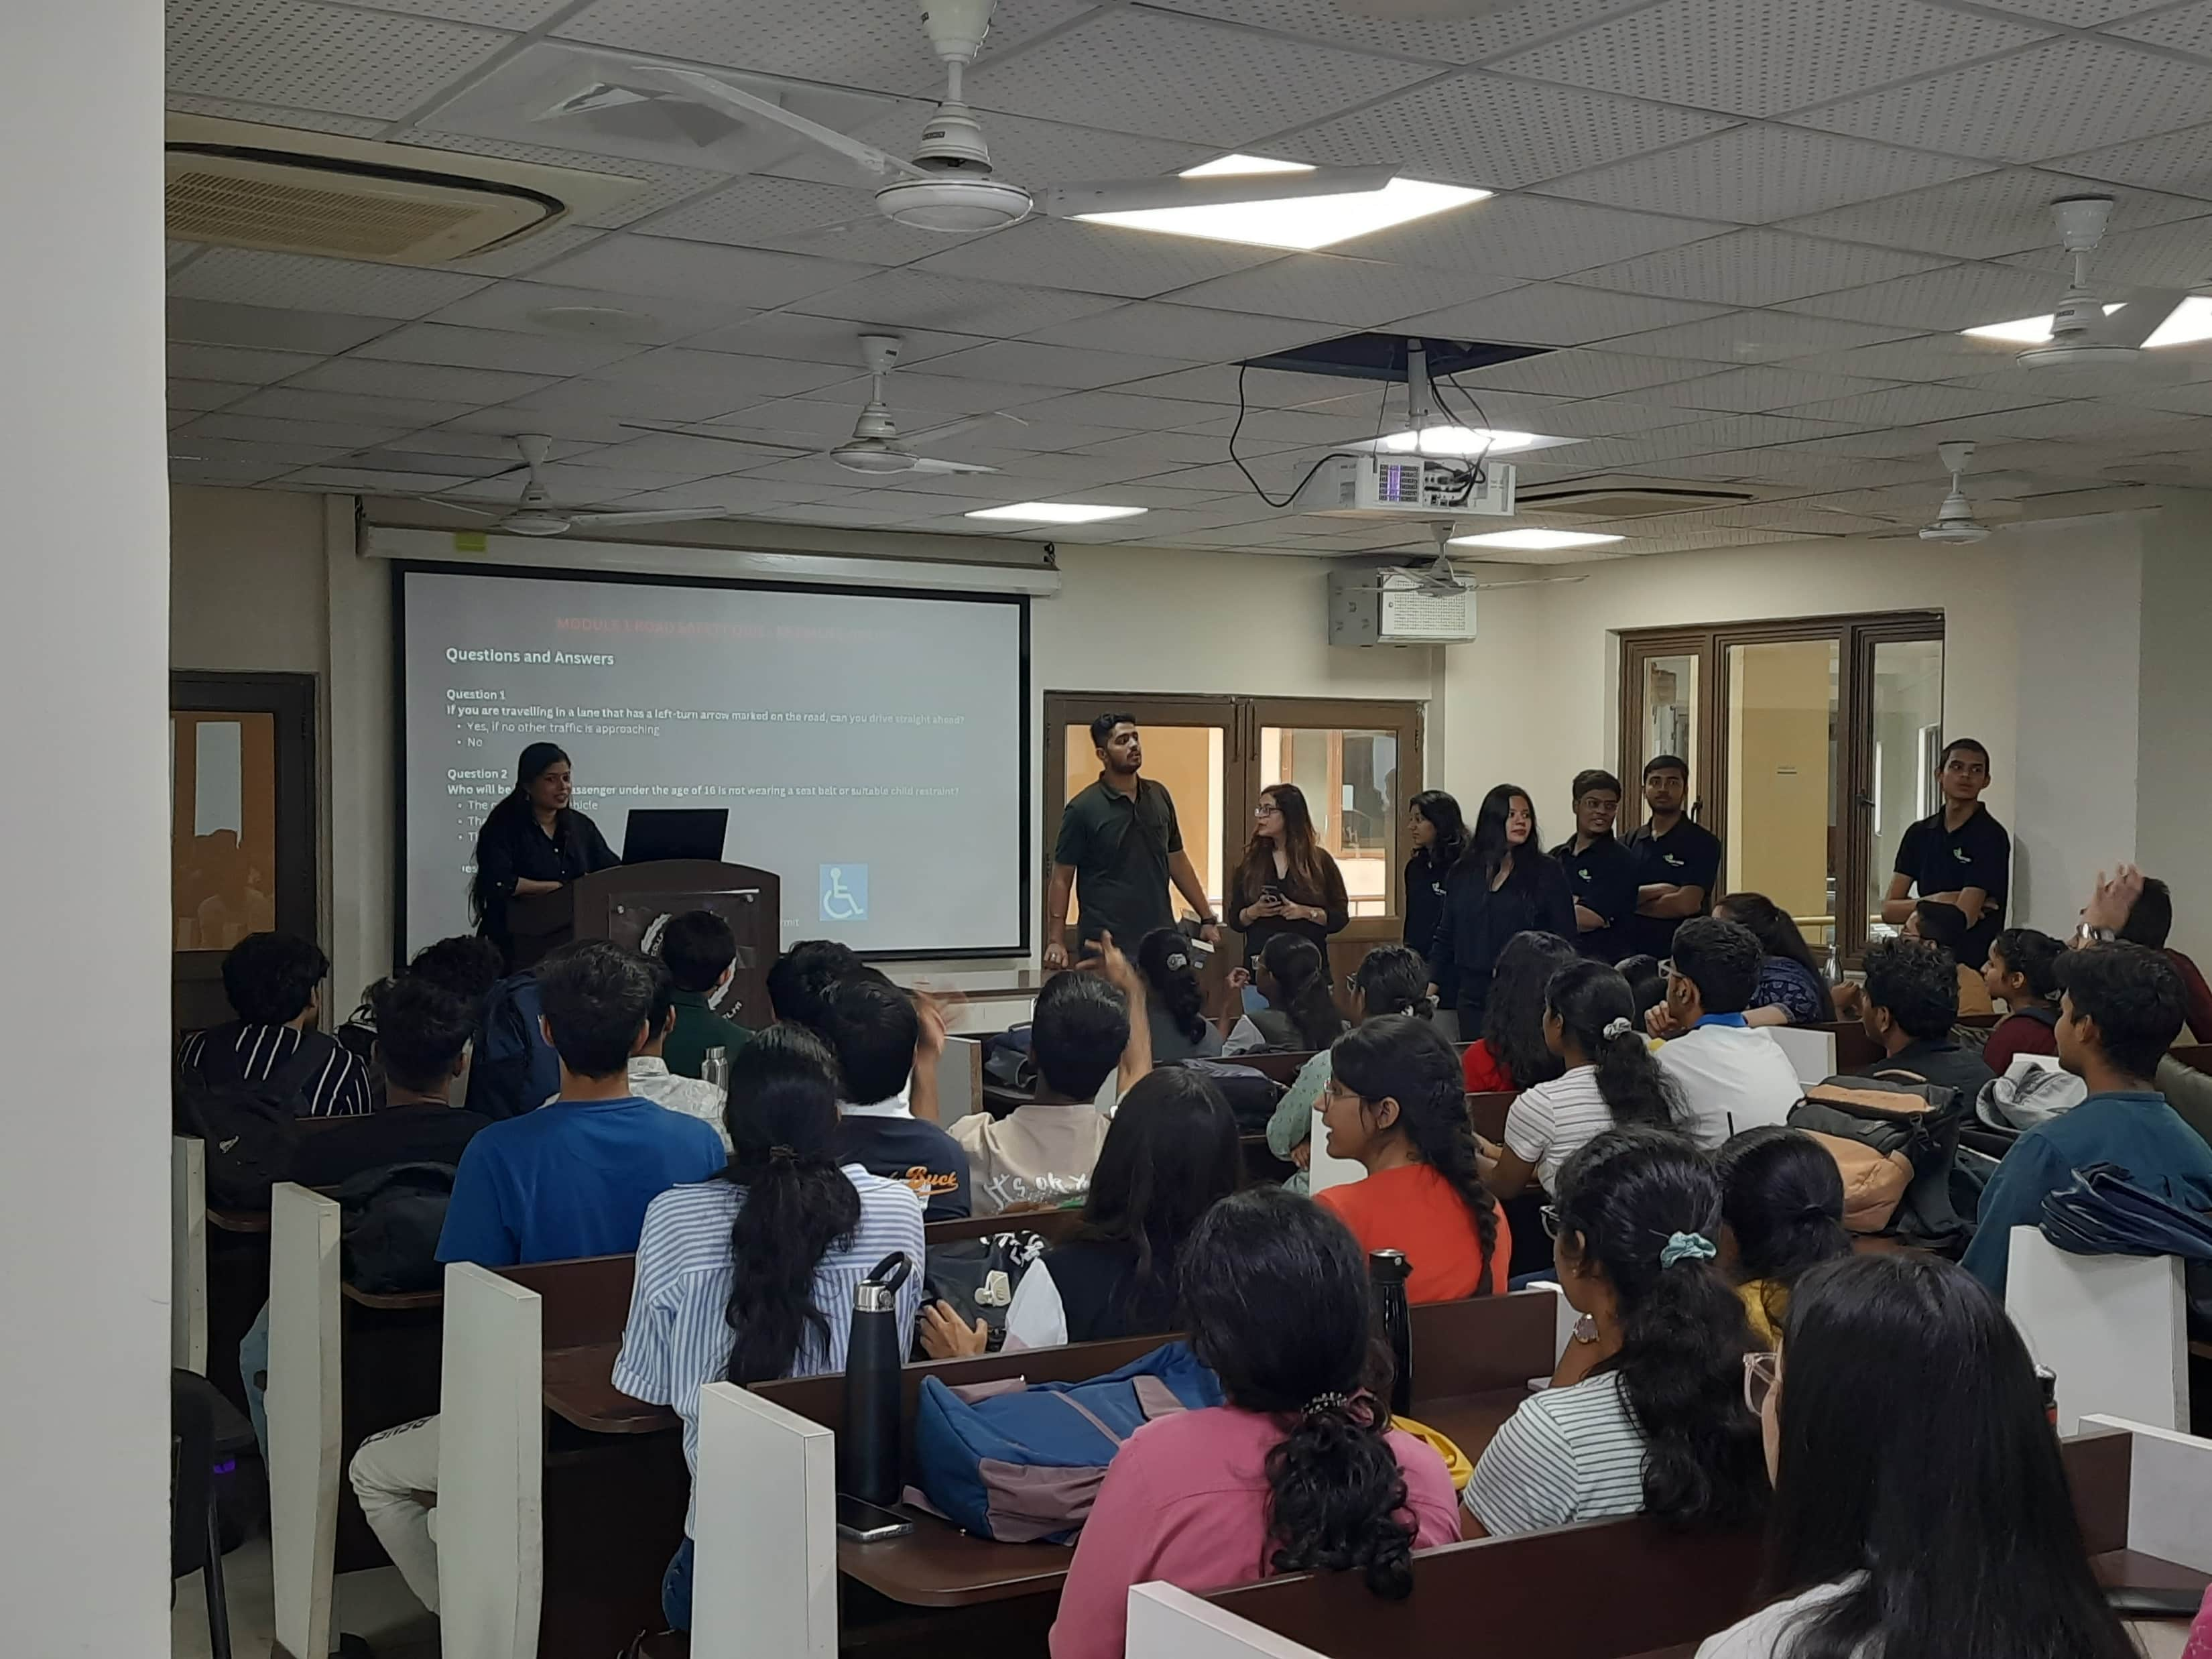
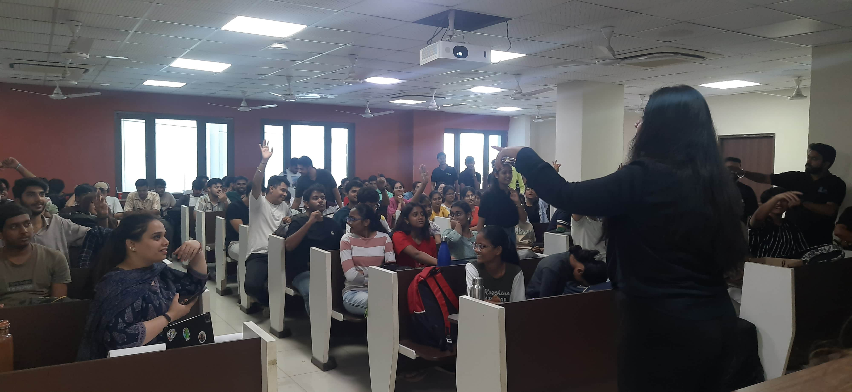
Conclusion
The Road Safety & First Responder Workshop was a resounding success, with participants gaining valuable insights and practical skills that will help them contribute to a safer community. The collaboration with Indian Road Safety Campaign, Hero MotoCorp, and the IIHMR Institute ensured that the attendees received professional training on critical road safety measures and first aid techniques. The event not only increased awareness but also empowered students to take immediate action during emergencies, making roads safer for everyone.

