Slide 1


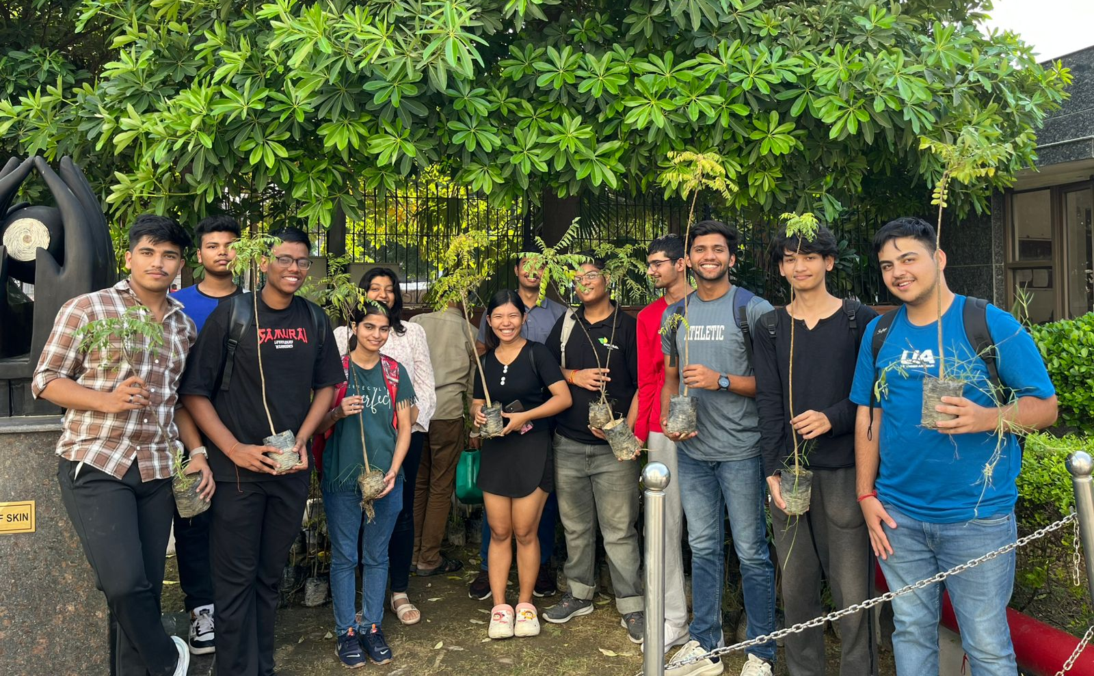
EVENT REPORT : Curry Leaves Plantation
Date: 14th October2024
Venue: Delhi NCR
Event Overview
On October 14th, 2024, EcoClub of Shaheed Sukhdev College of Business Studies organized a plantation drive to promote environmental sustainability and raise awareness about the importance of greenery in urban spaces. The initiative focused on planting curry leaf plants, known for their ecological and culinary benefits, within the college premises. This drive was a part of EcoClub’s ongoing commitment to fostering an environmentally conscious community.The plants were sourced from Green Ocean Nursery, ensuring high-quality saplings for the event. The plantation drive aimed to inspire collective action toward sustainability and encourage students and faculty to contribute to a greener future.
Participation
The plantation drive saw enthusiastic participation from students, faculty members, and staff of Shaheed Sukhdev College of Business Studies. EcoClub played a pivotal role in coordinating the event, managing logistics, and guiding participants throughout the process.Around 200 curry leaf plants were planted successfully, with participants showing great enthusiasm and commitment. The collective effort demonstrated the power of teamwork in achieving meaningful environmental goals and highlighted the community's dedication to sustainable practices.

Slide 2
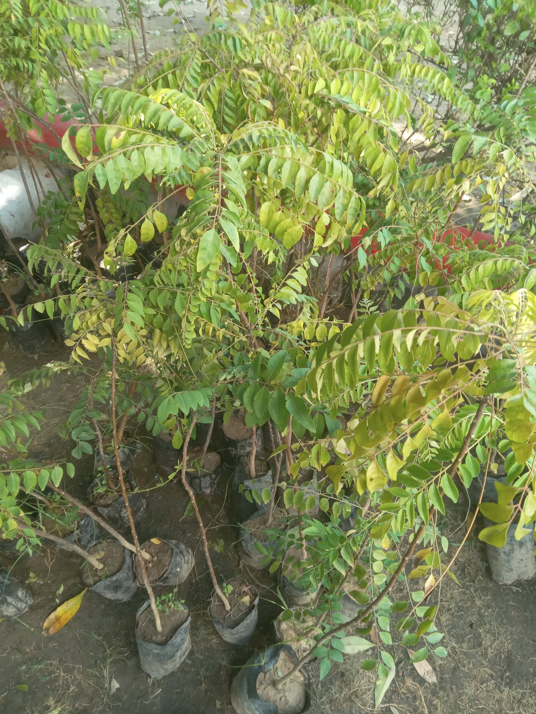
Activities
Procurement of Plants: EcoClub sourced 200 curry leaf saplings from Green Ocean Nursery, ensuring that the plants were healthy and ready for plantation.
Preparation: The designated plantation area within the college was prepared in advance, including clearing the ground and marking planting spots.
Plantation Process: On the day of the event, participants were provided with necessary tools and guidance by EcoClub volunteers. Each participant planted at least one sapling, ensuring proper care and placement.
Awareness and Engagement: EcoClub members shared insights about the environmental benefits of planting trees, especially curry leaf plants, which contribute to better air quality and provide useful resources.
Post-Plantation Care: Instructions were given for nurturing the plants, ensuring their healthy growth. EcoClub also set up a follow-up plan to monitor the saplings regularly.
Impact
Improved Greenery: The plantation of 200 curry leaf plants added to the greenery within the college premises, contributing to better air quality and biodiversity.
Awareness: The event raised awareness among participants about the importance of trees and their role in combating climate change.
Community Benefits:
Skill Development: Participants learned about the planting process and the importance of aftercare for saplings, fostering practical environmental stewardship skills.
Collective Action: The drive strengthened the sense of community within the college, as students and faculty worked together toward a common goal.
Long-Term Vision:
The curry leaf plants are expected to grow into robust greenery, providing shade, improving the microclimate, and symbolizing the college’s commitment to sustainability.
Conclusion
The plantation drive organized by EcoClub on October 14th, 2024, was a resounding success. With active participation and enthusiasm from students, faculty, and staff, 200 curry leaf plants were planted within the college premises.This event not only contributed to environmental improvement but also instilled a deeper sense of responsibility and teamwork among participants. EcoClub remains committed to organizing such initiatives in the future, driving the college community toward a greener and more sustainable tomorrow.

